Slide 1


Bay Bridges
Abhishek Gupta

Slide 2
AGENDA
TERMINOLOGY
OVERVIEW
SOLUTION
TOOLS

Slide 3
TERMINOLOGY
Line = Bridge Coordinate = Point
List = Array
Notes:
I didn’t really understand the scope of the problem, but I understood the math. I treated a bridge as a line and point as coordinate and labelled them as such in my program. It was easier for me to understand.
You can think of Python lists as arrays even though there are slight differences (i.e. Python lists can hold a variety of datatypes).

Slide 4
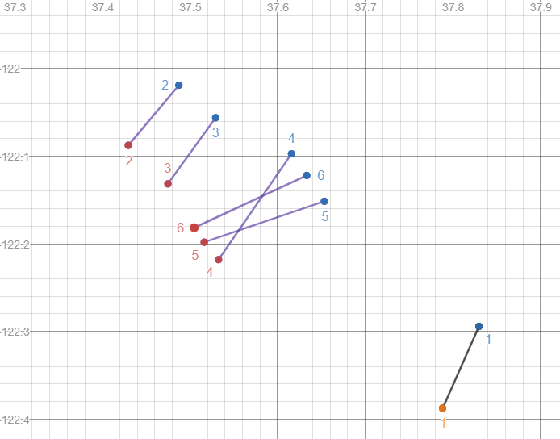
OVERVIEW
OUTPUT: 1 2 3 5 6
Notes:
The goal of the problem is to find the largest set of lines where no intersection exists. So we cannot simply throw out a line if it has an intersection.
The output is 1 2 3 5 6.

Slide 5
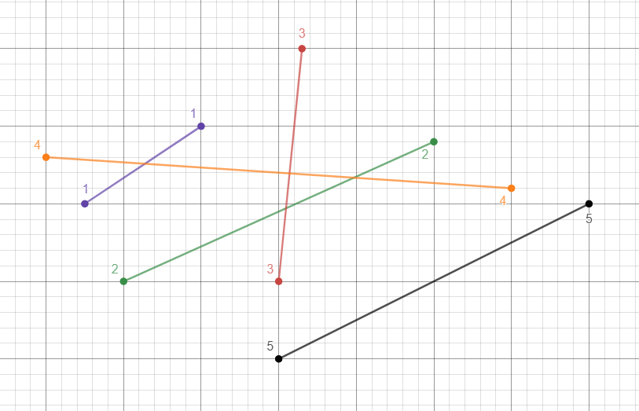
SOLUTION – Solving a Custom Example
Notes:
I’m going to go over a custom example. I will either draw this on the board or add more slides detailing step-by-step what is going on.

Slide 6





Notes:
Python 3 for the program. Git for version control. GitHub for repository hosting.
Cloud9 for integrated development environment.
Desmos for graphing (easy visualization for other outputs).

